Slide 1
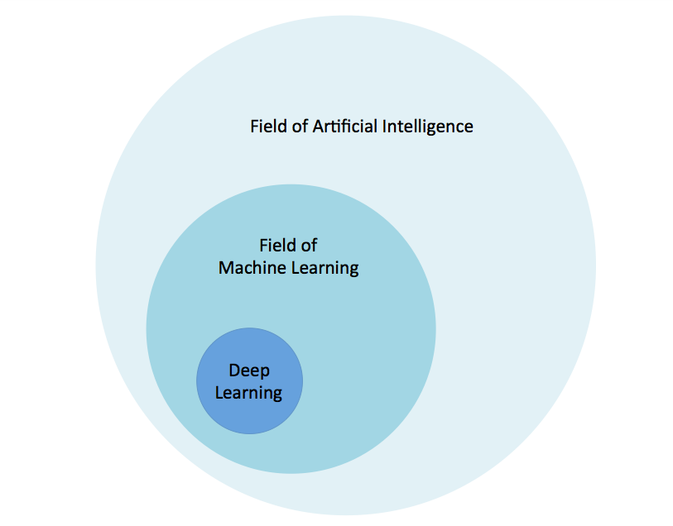
Deep Learning

Slide 2
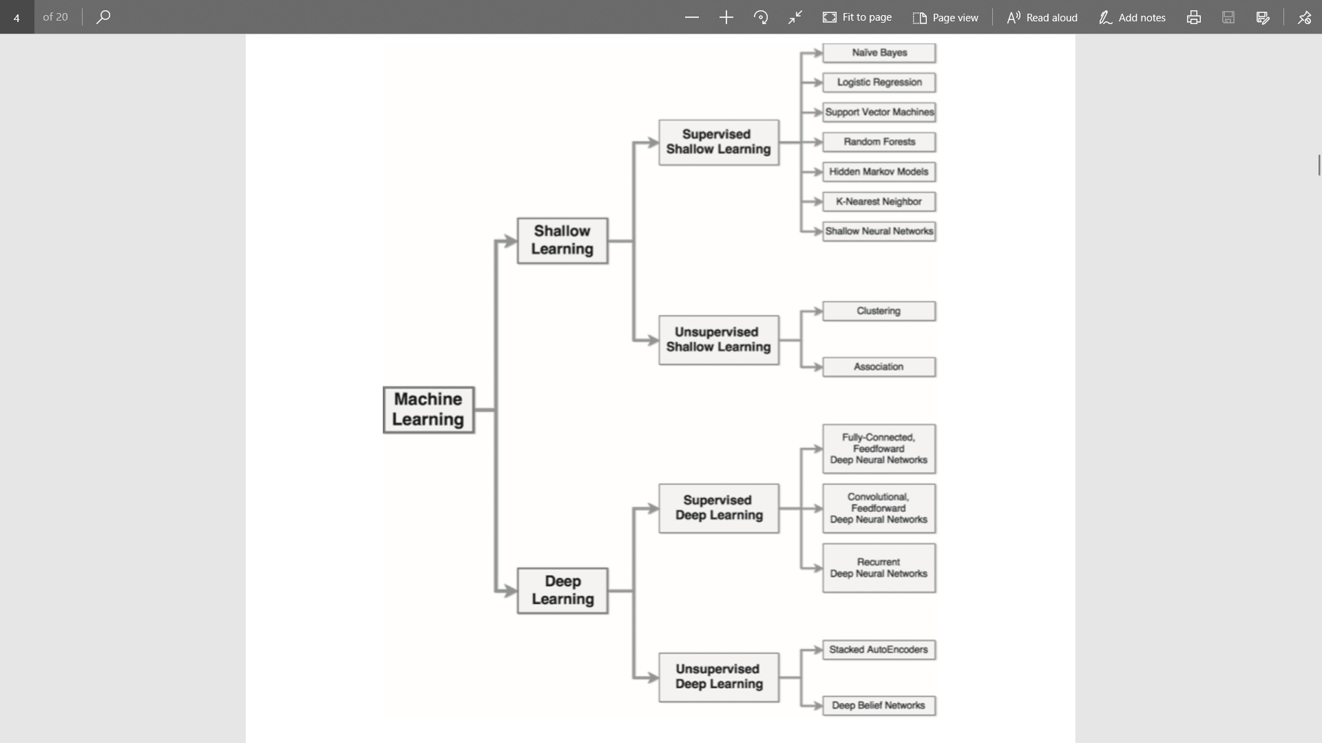
DL
vs
ML

Slide 3
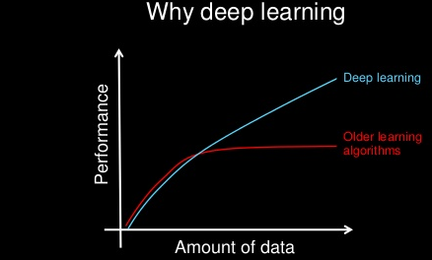
Intro to Deep Learning/Neural Network
Mimic the behavior of Human Neural Network
Large Dataset, multiple Features
Extensive learning.
Resource extensive, highly computational
Improved accuracy
Layered Architecture
Eats lot of data to learn Pattern
High Complexity
No Feature Engineering/Selection
Why : BIG Data, Highly Computational Resources, Modern Algorithm

Slide 4
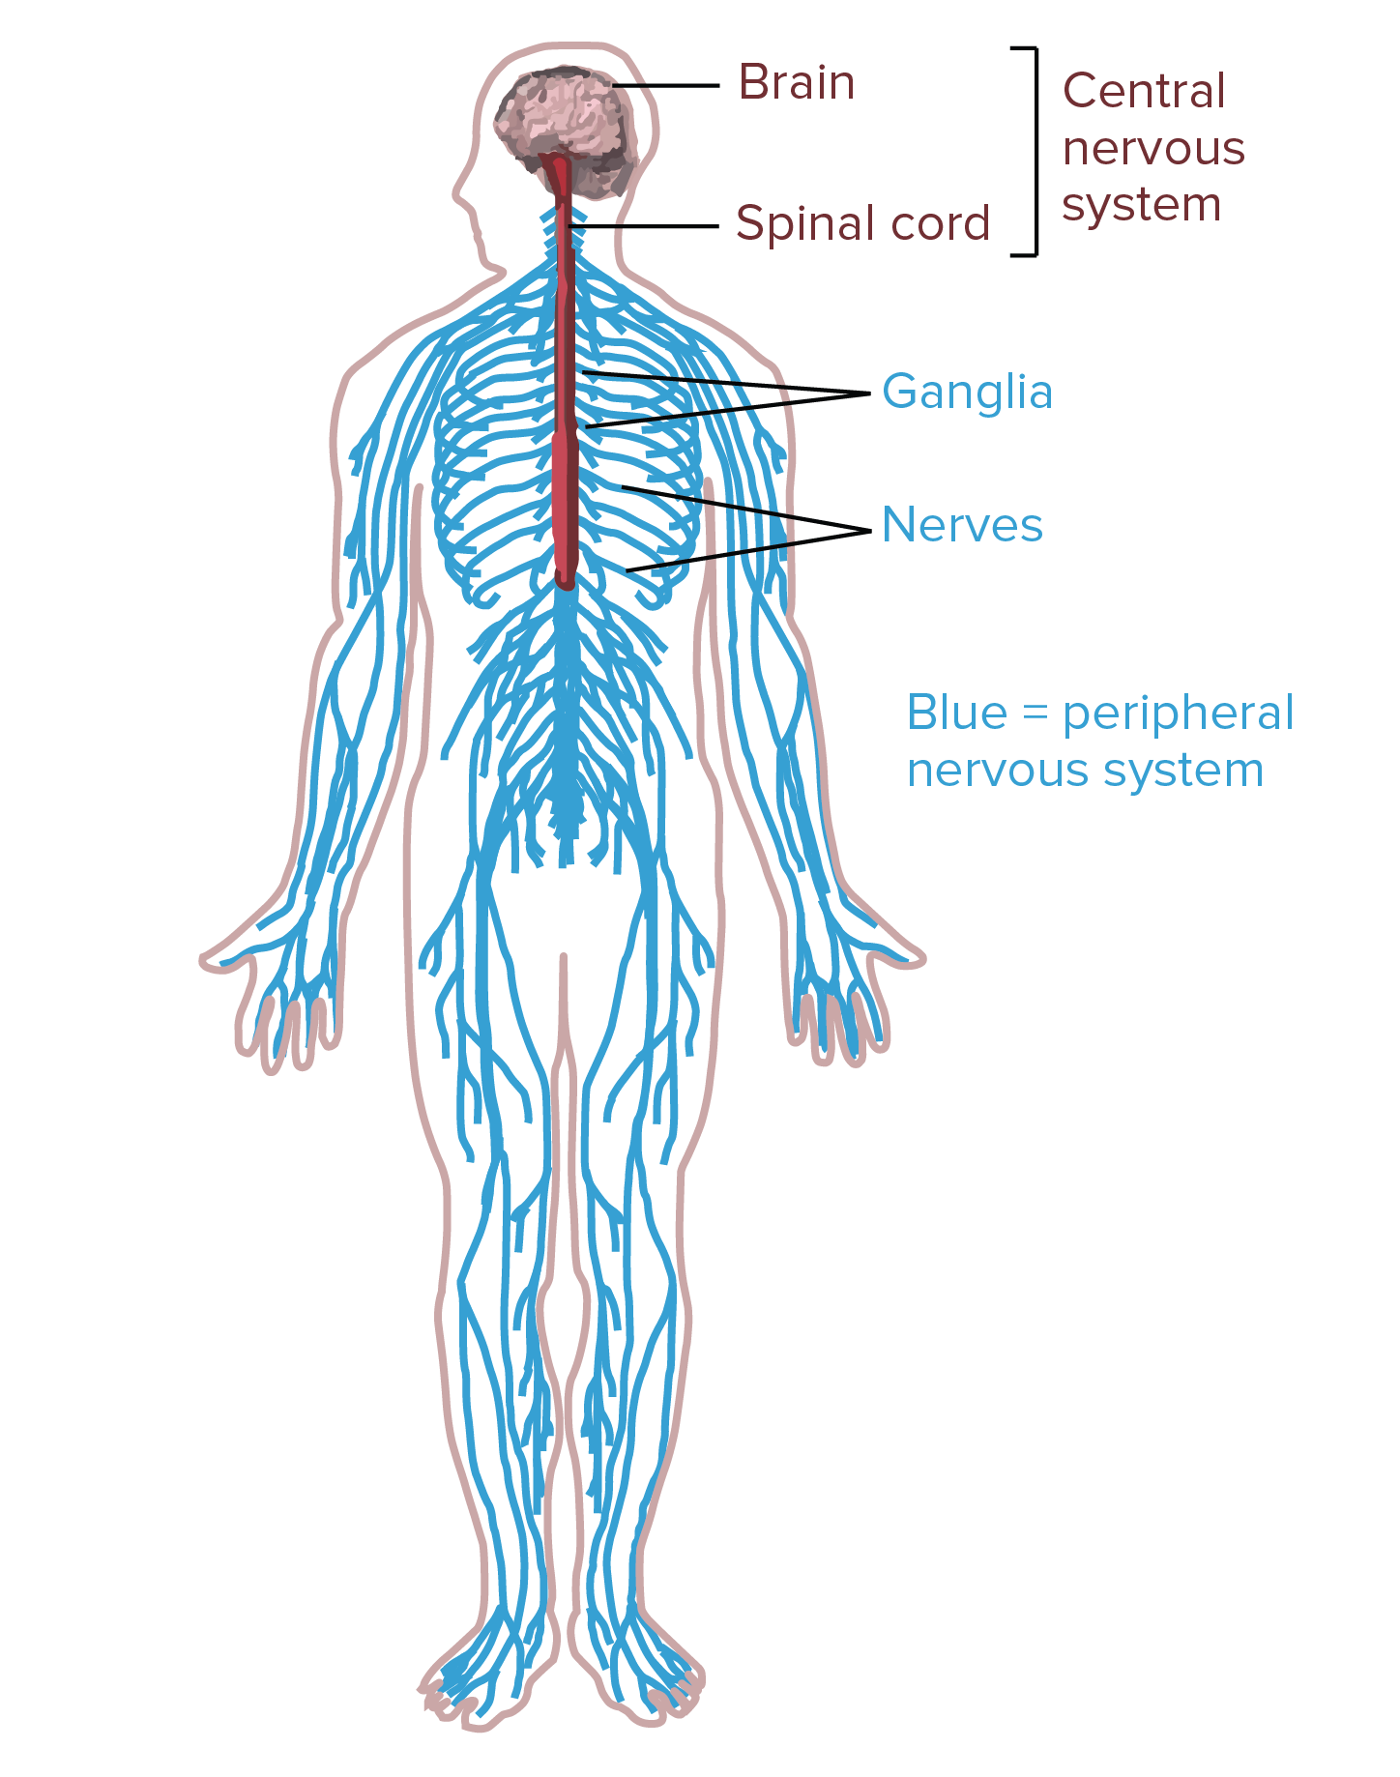
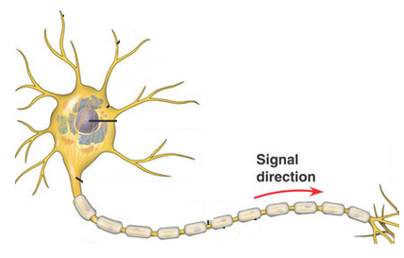
Human Nervous System
Human Body has approximately
86 billion neurons

Slide 5
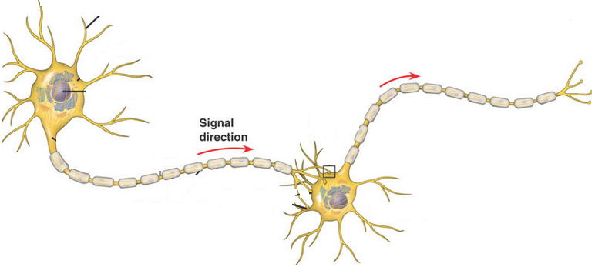
Human Nervous System
Human Body has approximately
86 billion neurons.

Slide 6
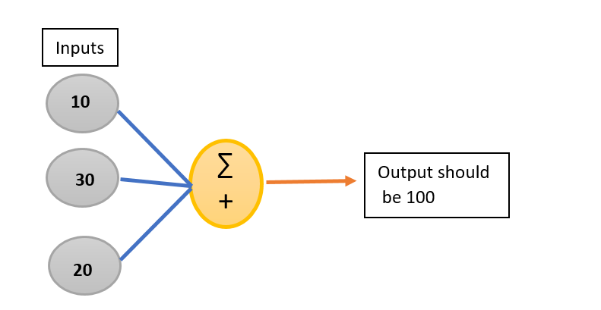
Maths Puzzle

Slide 7
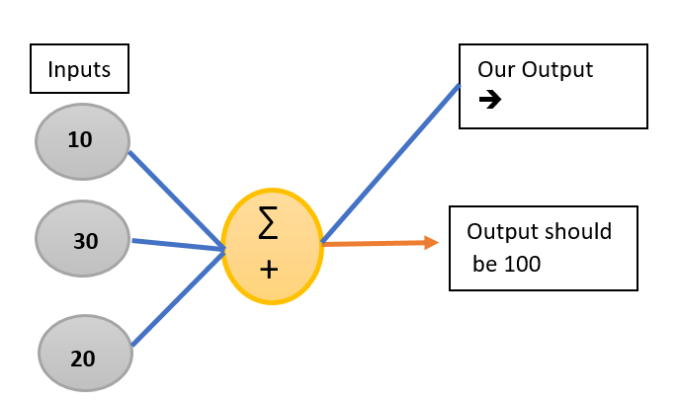
Maths Puzzle

Slide 8
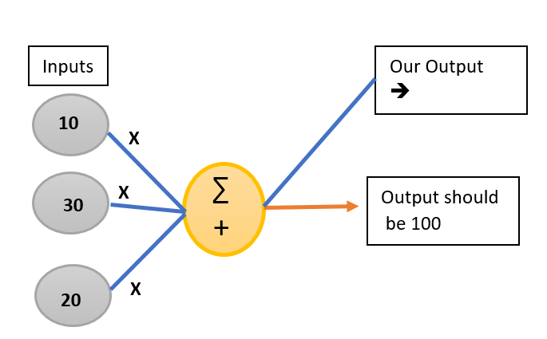
Maths Puzzle

Slide 9
Maths Puzzle

Slide 10
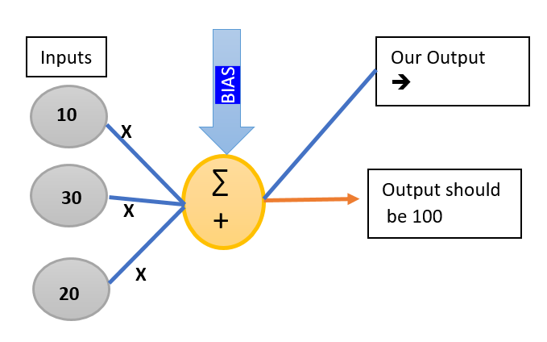
Maths Puzzle

Slide 11
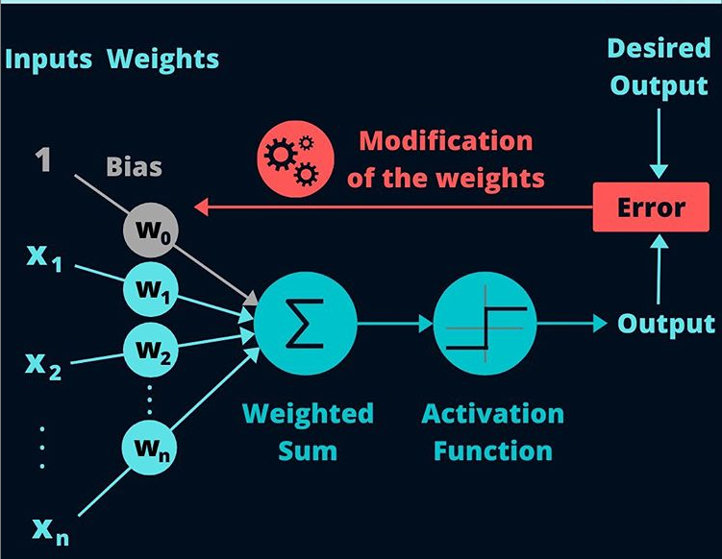

Slide 12
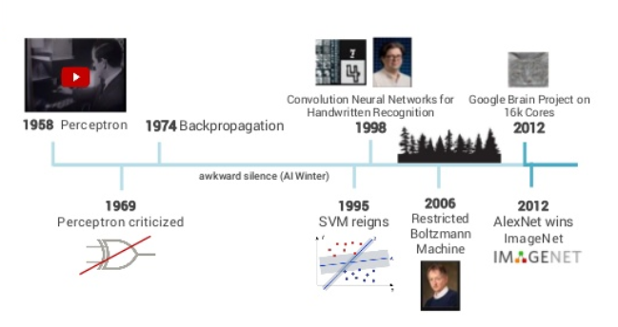
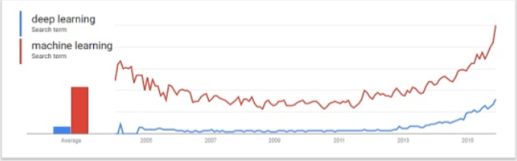
History of Deep Learning

Slide 13
Vocabulary
Input
Weights
Bias
Neuron
Activation Function
Error/Cost/Loss Function
Feed Forward Propagation
Backpropagation

Slide 14
Types Of Deep Learning
ANN : Artificial Neural Network
      Shallow and Deep
CNN : Convolution Neural Network
      image ,video , used to deal with Pixel
RNN : Recurrent Neural Network
      Time series Version of ANN.
      Most common RNN is LSTM and GRU
      Foundation of Forecasting models and language model
      Encoder, Decoder, Transformer and BERT……

Slide 15
Deep Learning Libraries
1) TensorFLow : Google
2) Keras : Google
3) Theano : university of Montreal,
4) Pytorch : Facebook
5) Caffe2: Facebook
6) CNTK : Microsoft
7) Chainer : Preferred Networks Japanese Startup
8) Mxnet :DMLC adopted by AWS
9) Sonet : Deep Minds
10) Onnx model : Facebook and Micrsoft
11) Gluon : Amazon and Microsoft
12) Caffe2 + Pytorch : Facebook

Slide 16
Applications
Speech/Audio Recognition
ComputerVIsion/ Images Classification/Recognition
NLP
Cybersecurity
Self Driving Cars
Unmanned Aerial Networks
And all other applications where MachineLearning works

Slide 17
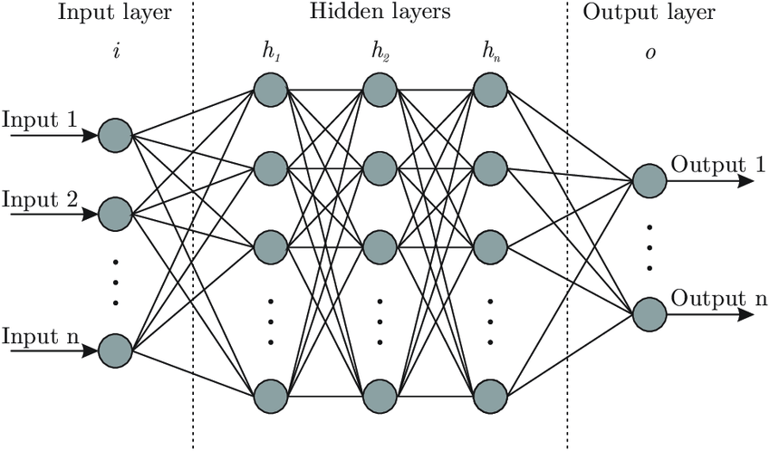
Neural Network
Collection of Neurons

